Slide 1
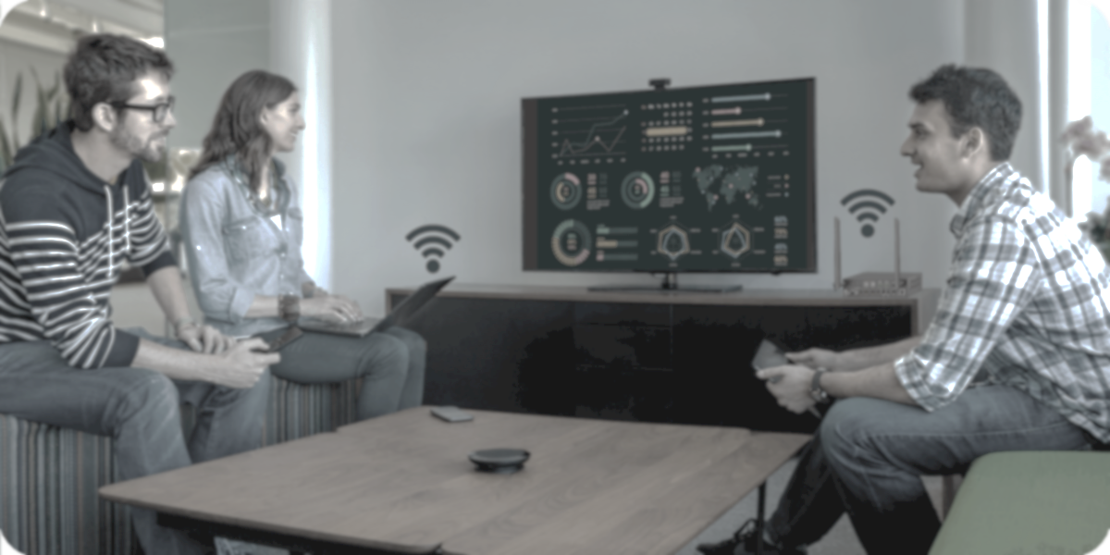
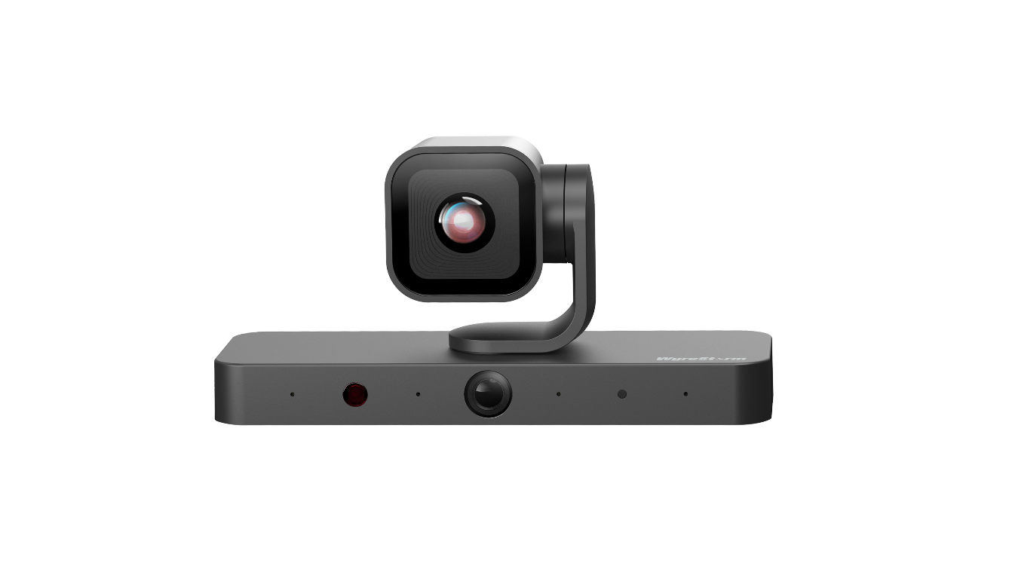

CAM-420-PTZ
Product Guide
4K Dual-Lens AI PTZ Camera with AI Features
4K Dual-Lens PTZ Camera with NDI & AI Features

Slide 2


Contents
Product Overview & Main Features
Why Choose Us?
Interface & Specifications
Typical Connection & Applications
Competitor Analysis
Quick Installation Guide
Q & A Session
Powerful · Reliable · Simple

Slide 3
Product Overview
4K dual-lens PTZ Camera with NDI & AI features
The CAM-420-PTZ is a 4K dual-lens AI tracking camera designed for medium and huddle rooms. It features a 3x optical zoom and 5x digital zoom PTZ camera with a 110° DFOV and a panoramic lens with a 120° DFOV. With four built-in microphones, it supports voice detection and audio tracking to deliver a more intelligent and engaging conferencing experience.
Powered by advanced AI technology, the camera offers Auto Framing, Speaker Tracking, Presenter Tracking, and Individuals Gallery for a more immersive meeting. NDI technology ensures seamless IP-based video distribution and flexible system integration. In addition, multiple installation options—on a conference table, on top of a TV, wall-mounted, or tripod-mounted—make it instantly ready for any meeting environment.
Powerful · Reliable · Simple

Slide 4
Why Choose Us: 1. Immersive Viewing Experience
Deliver an immersive conferencing experience with 4K high-resolution video, a dual-lens design, and built-in PIP functionality – ensuring stunning detail and captivating visuals throughout the meeting.
4K high-resolution video
Dual-lens design
Supports up to 4K@30fps video output via HDMI, USB-C, and NDI, ensuring superior image clarity for your presentations.
Features a built-in dual-lens system: a 4K PTZ camera with a 110° DFOV to capture every detail of participants in the room, and a 120° DFOV panoramic lens to capture the entire meeting space.
Built-in PIP functionality
The built-in PIP feature allows participants to view multiple perspectives simultaneously — for example, seeing both the speaker and the room view at once — creating a more dynamic conferencing experience.
Powerful · Reliable · Simple

Slide 5
Why Choose Us: 2. Smart AI-Powered Experience & NDI Support
Smart AI enables effortless Auto Framing, the Individuals Gallery feature, and intelligent tracking to maintain a natural meeting flow. Meanwhile, NDI technology delivers high-quality streaming for seamless integration into any professional setup.
Precise and smooth tracking experience
Individuals Gallery merges close-ups
Supports Auto Framing, Speaker Tracking, and Presenter Tracking to enhance tracking stability and provide a smoother, more reliable experience.
The Individuals Gallery feature presents dedicated close-up views of each attendee in the room. This significantly improves visibility, enhances engagement, and creates a more immersive meeting experience.
NDI | HX for flexible IP workflows
NDI technology offers greater system flexibility. All NDI-compatible devices on the same network can be accessed easily, enabling more sources to be used for hybrid teaching and meetings.
Powerful · Reliable · Simple

Slide 6
Why Choose Us: 3. Multiple Installation Options, Plug & Play
Multiple installation options simplify the setup process, making it easy for guests to connect and present effortlessly.
Multiple Installation Options
Simplified Setup
Flexible installation options—including placement on a conference table, on a display, on the wall, or on a tripod—make the system adaptable to any meeting environment.
Plug-and-play functionality allows guests to connect and start presenting easily, without the need for additional software or complex configuration.
Powerful · Reliable · Simple

Slide 7
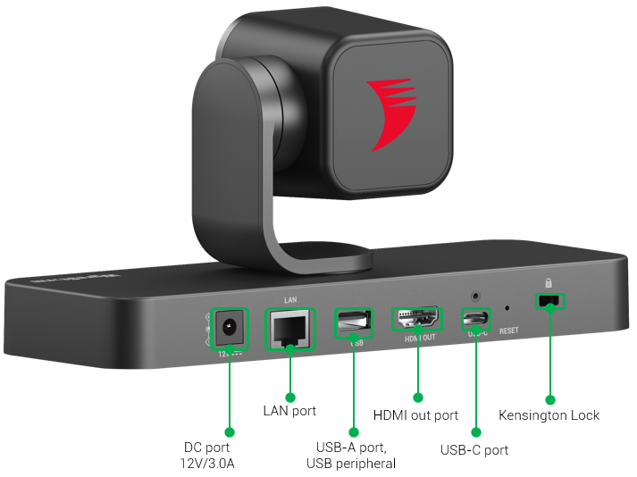
Interface of the Product
Front Panel
Featuring:
USB-C output
Connect to a laptop or base unit (e.g., SW-640L-TX-W, MX-0403-H3-MST, MX-0402-MST, NHD-500 series, etc.) to create an immersive hybrid meeting experience.
HDMI output
Connect to a display with high-quality video up to 4K@30Hz.
Ethernet Port
Connect to a network switch for remote device management via the web interface, or for NDI transmission to deliver video over Ethernet.
Rear Panel
Powerful · Reliable · Simple

Slide 8
Specifications & Packing List
Main Specifications
Outputs | 1x USB-C output, 1x HDMI output, 1x NDI output
Video Resolution (Max) | 4K@30fps
Output Video Encoding | MJPEG (default) | H.265 | H.264 | NV12
Sensor | AI lens: 8MP | 3x optical zoom; 5x digital zoom | DFOV: 110° Panoramic lens: 2MP | Fixed lens DFOV: 120°
Rotation | Horizontal: ±75°| Vertical: ±45°
Smart AI | Auto Framing (default as on), Speaker Tracking Presenter Tracking, Individuals Gallery
Microphone | 4x MEMS mic array Pickup Range: 5m * Note: MIC is used for internal AI processing and does not capture audio for hybrid transmission in conferences;
USB | 1x USB-C: USB 3.2 Gen 1 | Max Bandwidth: 5.0 Gbps
 | 1x USB-A: USB 2.0 | Max Bandwidth: 480Mbps
Ethernet | 1x LAN port | NDI output | Web UI | API
Control Method | Web UI | RCU | API
Power Supply | 12V DC 3A
What’s in the Box?
1x CAM-420-PTZ Camera
1x 12V/3.0A Power Supply (US, UK, EU, AU)
1x USB-C to USB3.0 Type-A cable (1.8m)
1x Mounting Kits (installation on table or wall)
1x Quick Start Guide
1x Remote Controller
1x Privacy Cover
Powerful · Reliable · Simple

Slide 9
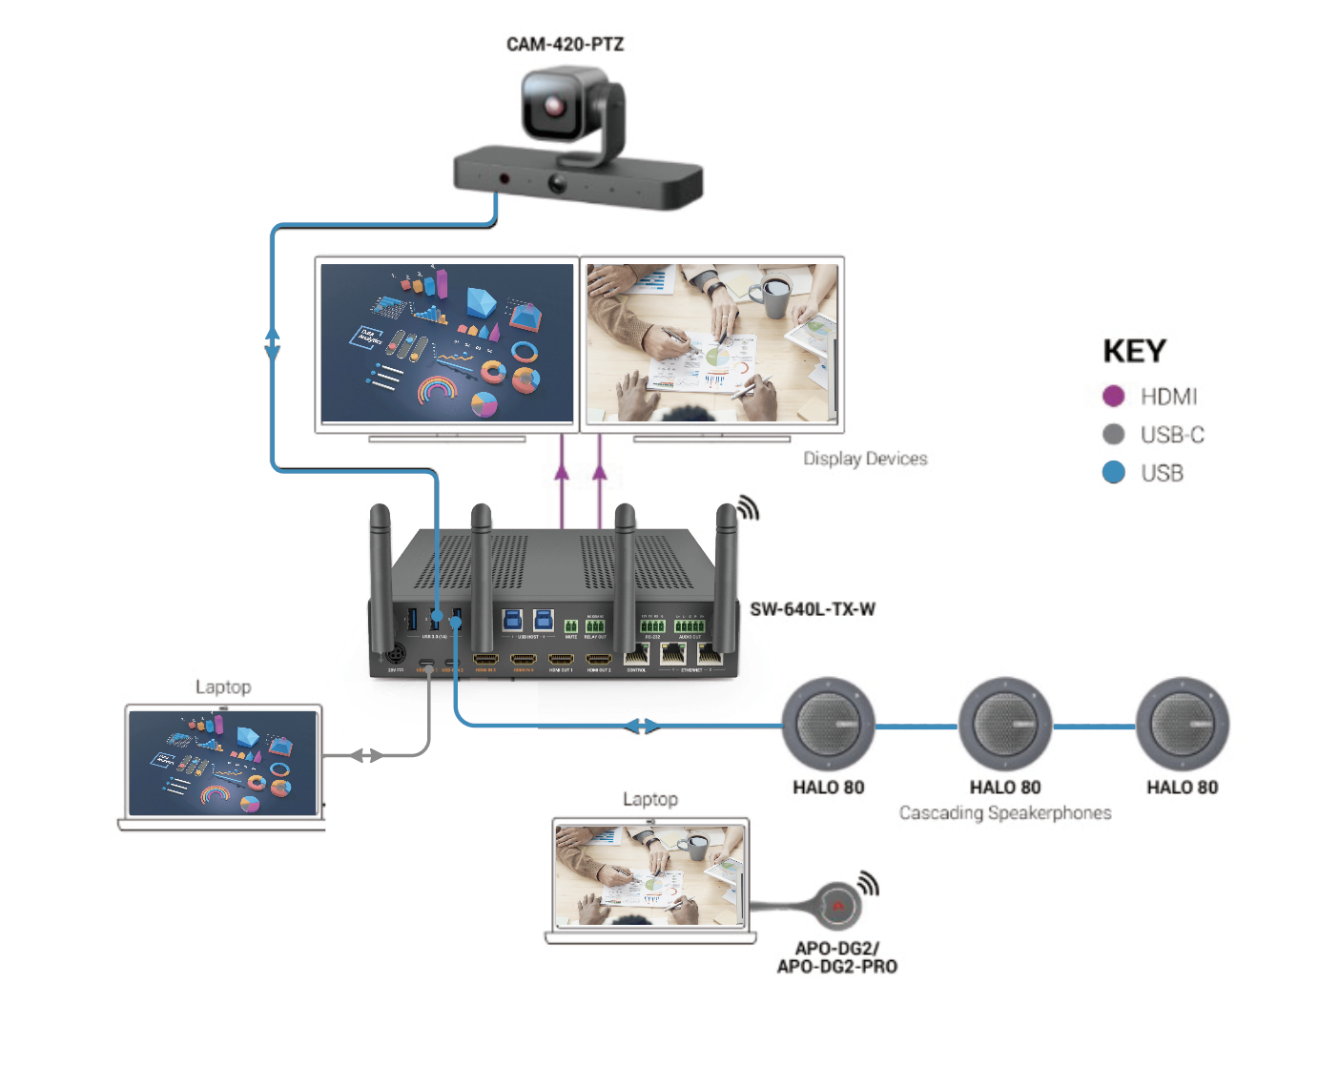
Typical Connection & Applications
Application Scenario 1: Medium Conference Room
Deliver a professional hybrid meeting experience with the CAM-420-PTZ camera and HALO-80 speakerphone. Participants can easily share content, interact with remote colleagues, and enjoy a seamless and efficient meeting experience.
Key Benefits Include:
Multiple casting methods : Simplifies presentations with various options.
Hybrid Teaching & Meeting : Connects to the CAM-420-PTZ and HALO-80 speakerphone to provide a professional hybrid conferencing experience.
Flexible control methods : Quick and smooth control by RS232, or Web-UI or working with our In-Desk Box.

Slide 10
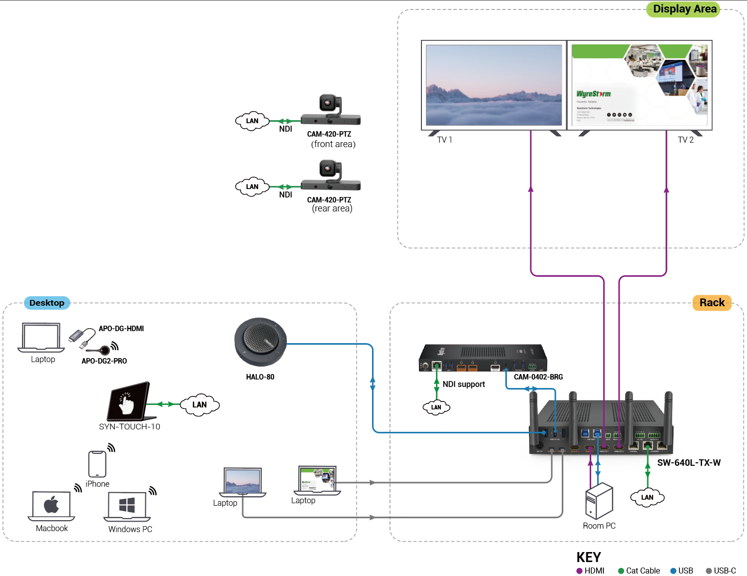
Typical Connection & Applications
Application Scenario 2: Medium Conference Room (NDI)
Designed to create a seamless, professional hybrid experience with NDI technique (CAM-420-PTZ, CAM-0402-BRG). Participants can easily share content, interact with remote colleagues, and enjoy a professional and efficient meeting experience.
Key Benefits Include:
Multiple casting methods : Simplifies presentations with various options.
NDI® | HX2 for NDI cameras: Enables video sources to be transmitted over Ethernet, allowing more sources to be integrated into hybrid teaching and conferencing setups.
Hybrid Teaching & Meeting : Connect to CAM-420-PTZ, speakerphone, we offer professional hybrid experience.

Slide 11
Comparison with Other Competitors
Features |  | CAM-420-PTZ | Logi Rally PTZ | Yealink UVC86 | Aver CAM570
Main Features | Resolution | Up to 4K 30fps | Up to 4K 30fps | Up to 4K 30fps | Up to 4K 30fps
 | AI tracking feature | Auto Framing Presenter Tracking Speaker Tracking Individuals Gallery | N/A | Auto Framing Presenter Tracking Speaker Tracking Smart Gallery | Auto Framing Presenter Tracking Speaker Tracking Smart Gallery
 | Picture Mode | Single / PiP | Single | Single / PiP | Single / PiP
 | Outputs | USB output: 4K@30fps HDMI output: 4K@30Hz NDI output: 4K@30Hz | USB output: 4K@30fps | USB output: 4K@30fps HDMI output: 4K@30Hz | USB output: 4K@30fps HDMI output: 4K@30Hz NDI output: 4K@30Hz
Lens | AI Lens | 8MP, 3x optical Zoom, 5x digital Zoom DFOV 110° | 8MP, 5x optical Zoom, DFOV 90° | 8MP, 12x optical Zoom, DFOV 90° | 8MP, 12x optical Zoom, DFOV 90°
 | Panoramic Lens | 2MP, fixed focus, DFOV 120° | N/A | 8MP, fixed focus, DFOV 120° | 8MP, fixed focus, DFOV 95°
Audio | Mic array* | 4x mics | N/A | 6x mics | 3x mics
Control Type |  | Remote Control, WEB UI | Remote Control Software | Remote Control, WEB UI | Remote Control, WEB UI
*The built-in mics are for the audio-tracking function, it cannot be used as an audio source for video-conferencing software.

Slide 12
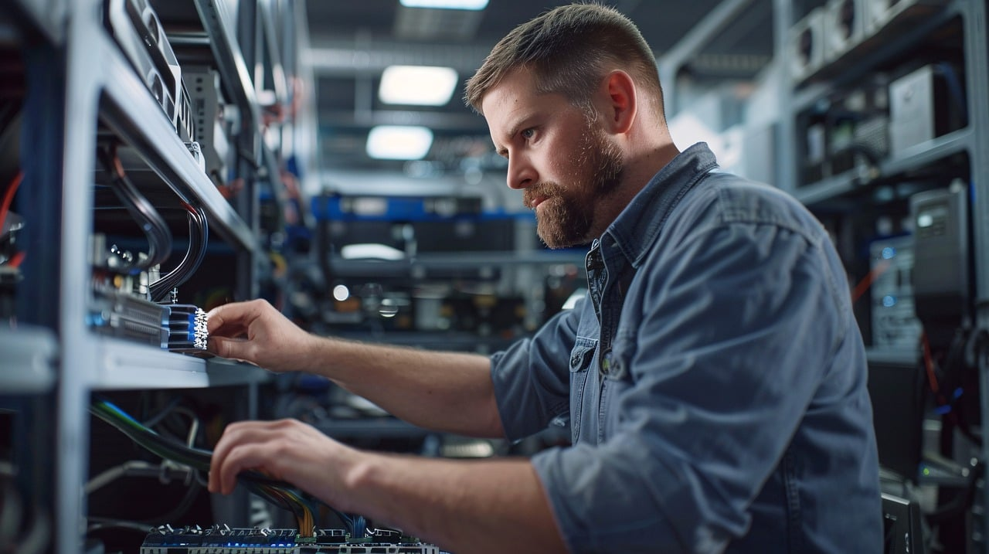
Quick Installation Guide
Effortlessly set up your conference camera with simple steps, ensuring hybrid configuration and an exceptional viewing and hybrid experience.
Connect Interfaces: Follow the standard product connection guidelines and customize connections based on your environment’s layout for optimal performance.
Create Your Hybrid Environment: Create your video, audio, USB settings using the Web-UI. For detailed instructions, refer to the user manual.
Enjoy Superior Visuals: Experience stunning video clarity and immersive visuals tailored to your needs.
Powerful · Reliable · Simple

Slide 13
Important Notes for Installation
Ensure all cables are securely connected to avoid performance issues.
Check your network settings and confirm that the device is on the correct subnet.
Double-check configuration settings in the Web-UI to optimize display and functionality.
For complex installations, refer to the documentation or seek professional assistance if necessary.
Powerful · Reliable · Simple

Slide 14

Final Thoughts
Q & A Session
Got questions? Don't hesitate to ask away.
Powerful · Reliable · Simple

